Slide 1
BUSINESS
VIDOUKIN
IT Service Outsourcing
Professional IT Intelligent Operation
Service Outsourcing Provider
Web : www.Vidoukin.com
Contact : sebastien.clement@vidoukin.com

Slide 2
Business Briefing
Vidoukin was found in Paris, France in 2012. Since company is continually extending its business in China, some offices have been established in Hong Kong, Shanghai, Shenzhen and Changchun etc., beside the Wuhan headquarter.
Vidoukin has owned the plentiful operation service experiences. Vidoukin is focusing on providing the international outsourcing service on the automotive and IT multiple industries etc., since it was found. The core businesses are help desk，IT resource outsourcing service and personalized customization service.
IT Service Outsourcing
PRIVATE & CONFIDENTIAL – DO NOT DIFFUSE WITHOUT VIDOUKIN APPROVAL

Slide 3
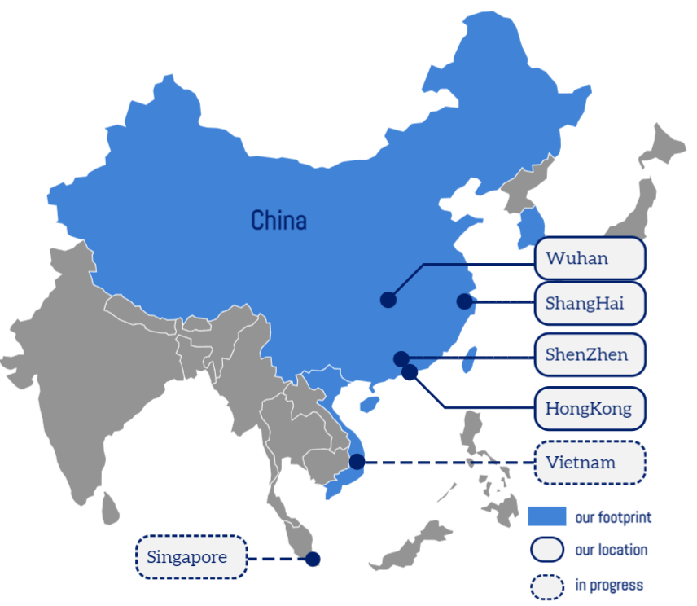
Vidoukin
Your engineering solution provider
2012
2013
2019
2021
2022
Creation of Vidoukin HK
Opening of Wuhan office
Opening of Shenzhen office
100th employee
Opening of Shanghai office
200+ employees and 400+ collaborator
China focus, worldwide footprint
40+
clients already trust us
PRIVATE & CONFIDENTIAL – DO NOT DIFFUSE WITHOUT VIDOUKIN APPROVAL

Slide 4
Activity & Expertise
Vidoukin core competence spreads across 3 mains industries
Automotive
Construction & Energy
IT Services
Tier 1 Supplier
OEM
Nuclear
Oil & gas
IT Opération
IT Outsourcing
IT Project
IT Solution
5%
IT services
15%
Construction & Energy
80%
Automotive
PRIVATE & CONFIDENTIAL – DO NOT DIFFUSE WITHOUT VIDOUKIN APPROVAL

Slide 5
IT Service
Back office support and consulting service to meet all kind of Enterprise IT requirements
IT helpdesk
Manage queries and complaints
Troubleshooting a number of IT problems and issues
User experience analysis and improvement
Software Engineering
IT support service
Cyber Security
Cybersecurity Awareness Training
local support
IT On-site Support
Internet Connection
Hardware
Software
IT Facility
Software development
C/C++, Java, Python
back-end/front-end development
Windows/Linux/Android/iOS operation system
Project management
Agile/waterfall development process
Team management 20+ engineers
PRIVATE & CONFIDENTIAL – DO NOT DIFFUSE WITHOUT VIDOUKIN APPROVAL

Slide 6
Vidoukin IT Operation Service
IT Operation Service - 1
IT Help Desk
On-site IT Support
Cyber Security Training
PRIVATE & CONFIDENTIAL – DO NOT DIFFUSE WITHOUT VIDOUKIN APPROVAL

Slide 7
IT Operation Service - 2
01
02
03
04
IT Connect
IT Routine Check
Hardware Issues
Diagnosis & Resolving
Software Issues
Diagnosis & Resolving
Internet Connect
Intranet Connect
Wireless Setup & Connect
Notebook PC
Desktop PC
Printer & Scanner
Others
Windows OS
MS Office
Virus Protection
IT Infrastruction & Device
Staff IT Security
Policy Introduction
IT Security Training
IT Device Procurement Support
PRIVATE & CONFIDENTIAL – DO NOT DIFFUSE WITHOUT VIDOUKIN APPROVAL

Slide 8
IT Service - Outsourcing
IT Outsourcing Service
Android/iOS
Engineer
WEB Front-end/Back-end Engineer
Java/Python Engineer
C/C++ Engineer
DBA
System Admin
Tester
Architect
UI/UE Designer
PRIVATE & CONFIDENTIAL – DO NOT DIFFUSE WITHOUT VIDOUKIN APPROVAL

Slide 9
IT Service - Project
IT Project Implementation
Business Requirement
Analysis
Function Design
UI Design
Database Design
Go-Live
IT Maintenance
System Integration Test
User Acceptance Test
PRIVATE & CONFIDENTIAL – DO NOT DIFFUSE WITHOUT VIDOUKIN APPROVAL

Slide 10
IT Service - Solution
IT Solution Provide
Enterprise Digital
Transformation
Customer Relationship
Management
Enterprise Data
Cloud Hosting
Website
PRIVATE & CONFIDENTIAL – DO NOT DIFFUSE WITHOUT VIDOUKIN APPROVAL

Slide 11
Service Industries
Why US ?
1
Plenty Support Experience
We have cooperated with many big famous IT company, provided services for many customers
2
Excellent Service Team
Our management Team knew the IT service well and we have had an experienced implement team.
Finance Industry
Telecom Industry
3
Flexibility
Customer can select the service with the scope and method which they really need.
4
Best Cost Price Rate
We provided the most reasonable and competitive service with the best CP rate.
Manufacturing Industry
Energy Industry
PRIVATE & CONFIDENTIAL – DO NOT DIFFUSE WITHOUT VIDOUKIN APPROVAL

Slide 12
Industry Pain Point
The Pain Point
1.Difficult to recruit professional
development staff
2.High cost on using and
managing technical staff
3.Difficult to built a team for an
urgent project
Solution
1.Provide the professional
development staff/team
2.Save the cost of enterprise
recruiting and management
3.Provide a set of team
building solution.
4.Meet the urgent resource
need of enterprise
PRIVATE & CONFIDENTIAL – DO NOT DIFFUSE WITHOUT VIDOUKIN APPROVAL

Slide 13
BUSINESS
We provide the best service and the best implementation solution for our customer
Please contact us for the detail information
Web : www.Vidoukin.com
Contact : sebastien.clement@vidoukin.com
PRIVATE & CONFIDENTIAL – DO NOT DIFFUSE WITHOUT VIDOUKIN APPROVAL

